Slide 1
Lecture 6
Different ways of presenting organic molecules
Constitutional isomers

Slide 2
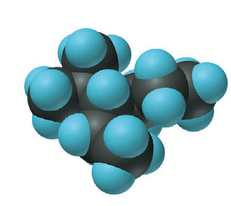
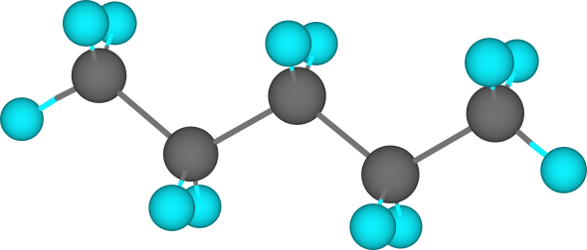
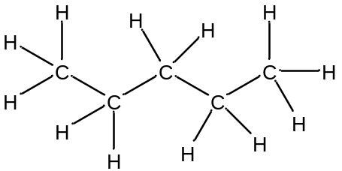
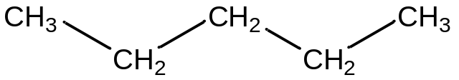

Space-filling model
Ball and stick model
Lewis structures:
Full formula (all atoms, bonds,
lone pairs)
Condensed formula (groups, bonds)
Carbon skeleton formula (only bonds
and atoms other than H, C)

Slide 3
Show atoms other
than C and H with
their Hs
End of line = CH₃
Angle = CH₂
OH
Angle = CH
Angle = C

Slide 4
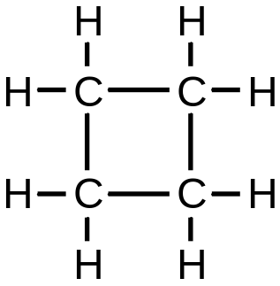
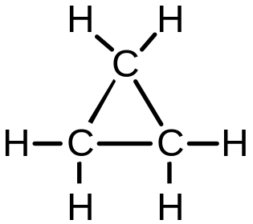
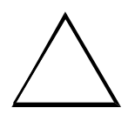

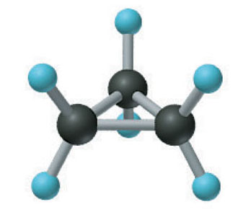
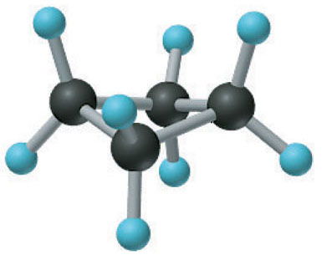
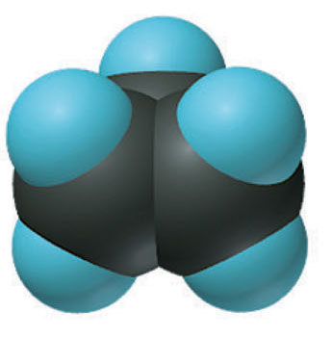
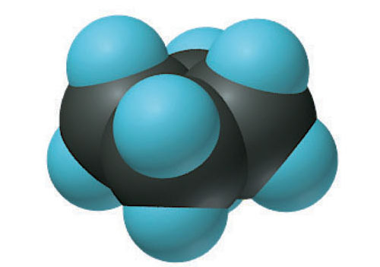
Depicting cycloalkanes
cyclopropane
cyclobutane

Slide 5
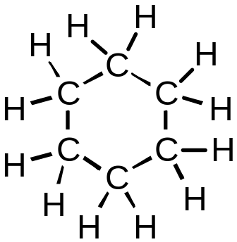
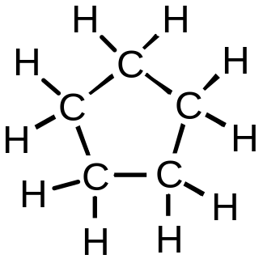
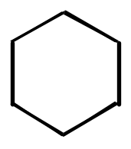
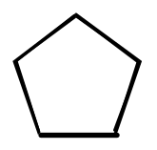
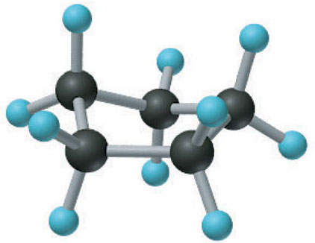
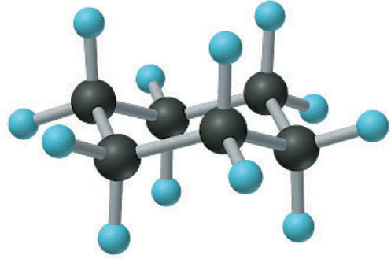
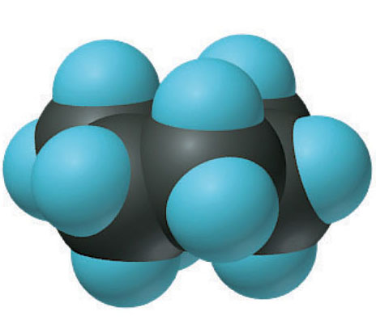
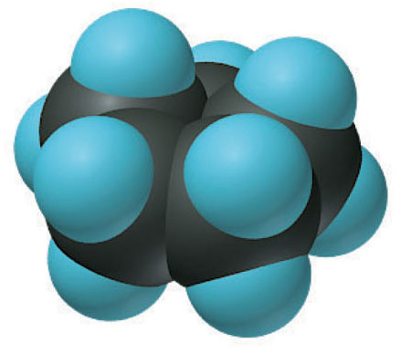
Depicting cycloalkanes
cyclopentane
cyclohexane

Slide 6
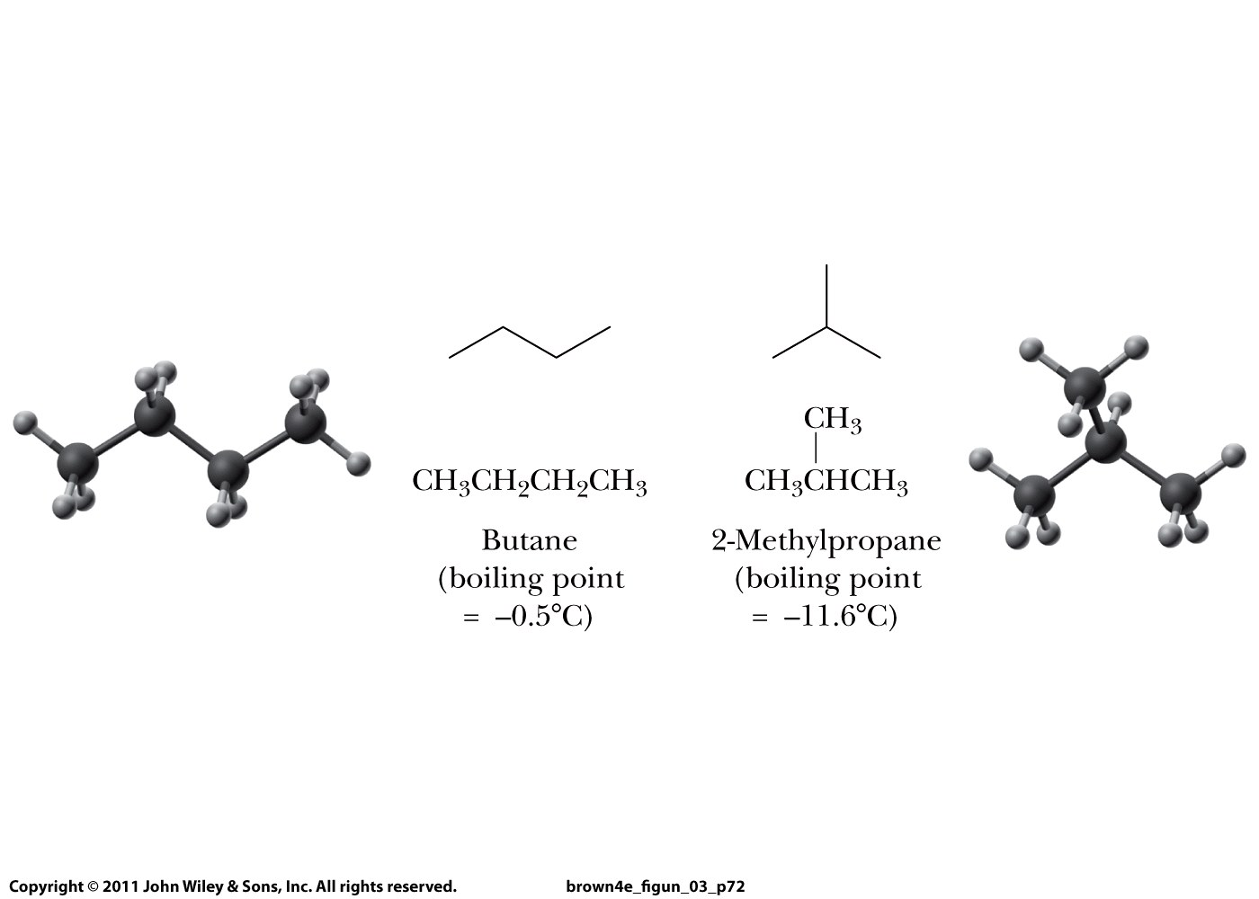
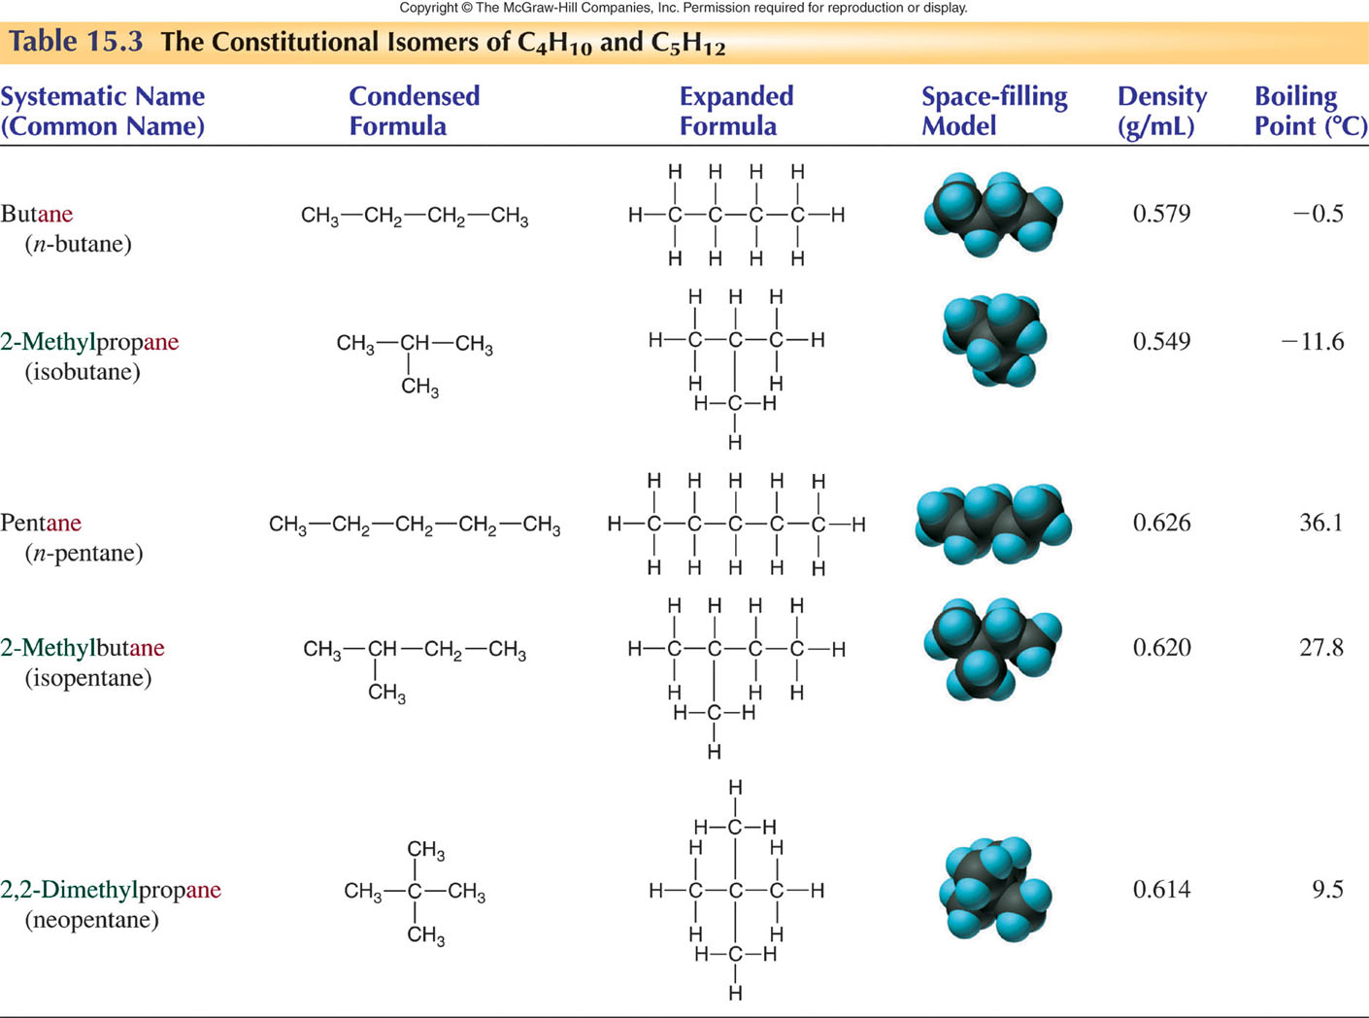
CONSTITUTIONAL ISOMERS

Slide 7




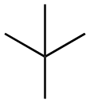
CONSTITUTIONAL ISOMERS
Carbon skeleton
formula

Slide 8
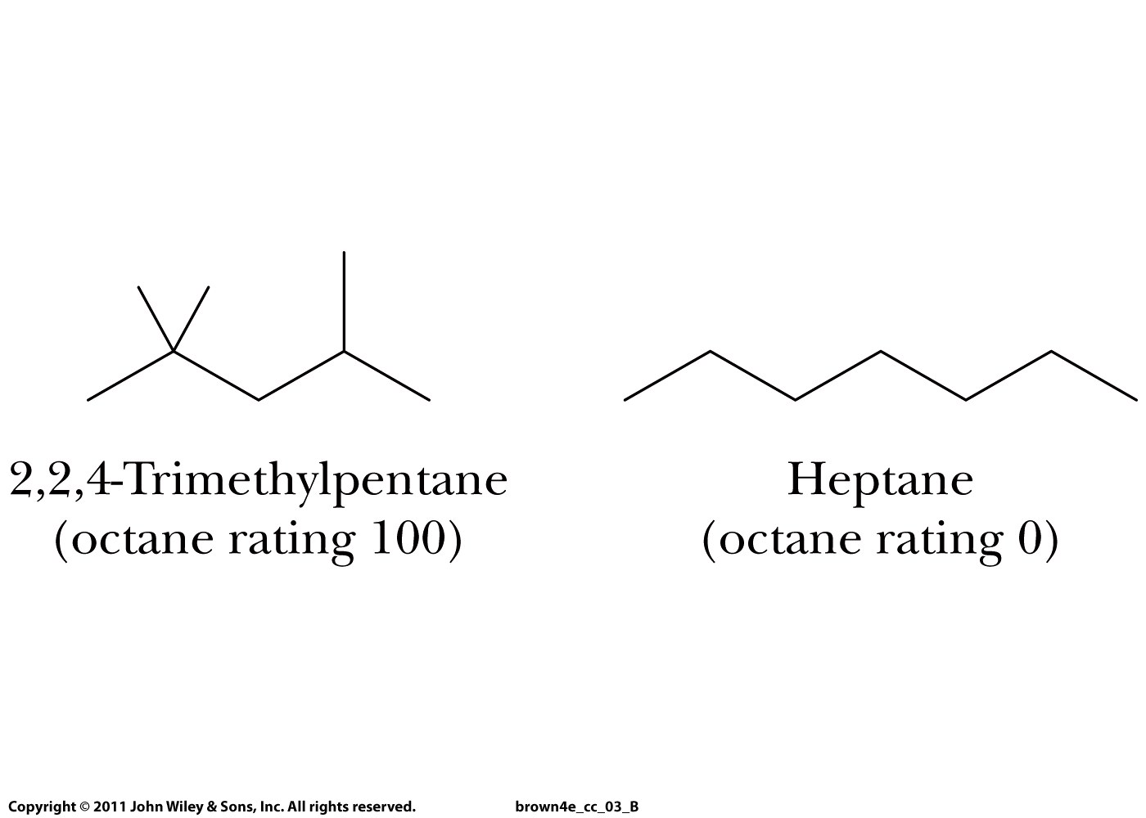
CONSTITUTIONAL ISOMERS

Slide 9
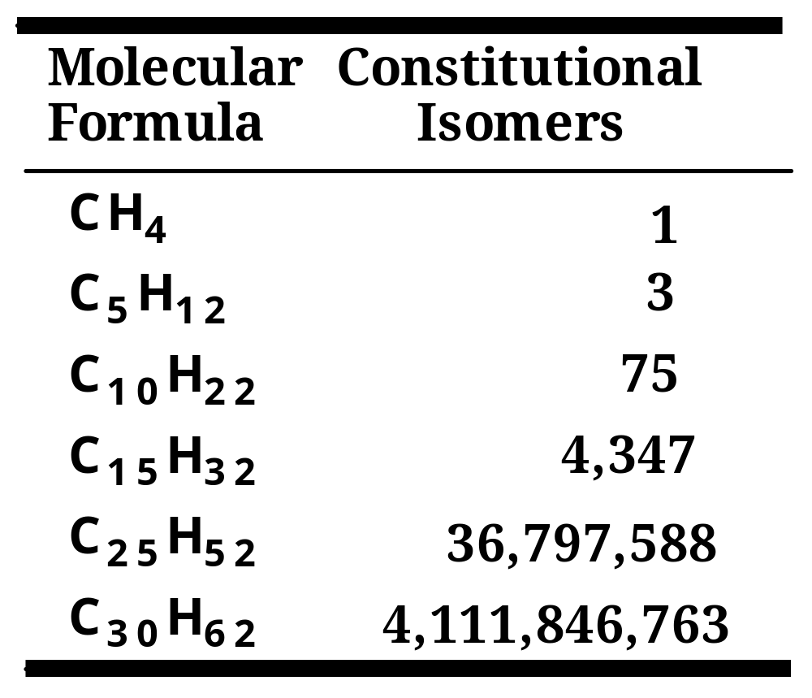
Constitutional Isomerism
  The potential for constitutional isomerism is enormous.
World population
is about
6,000,000,000

